Slide 1
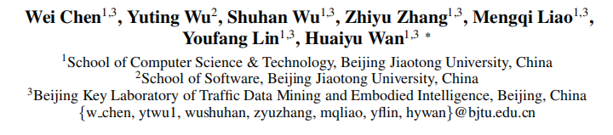





CognTKE: A Cognitive Temporal Knowledge Extrapolation Framework
（AAAI-2025)
Reported by Jiale Shen

Slide 2
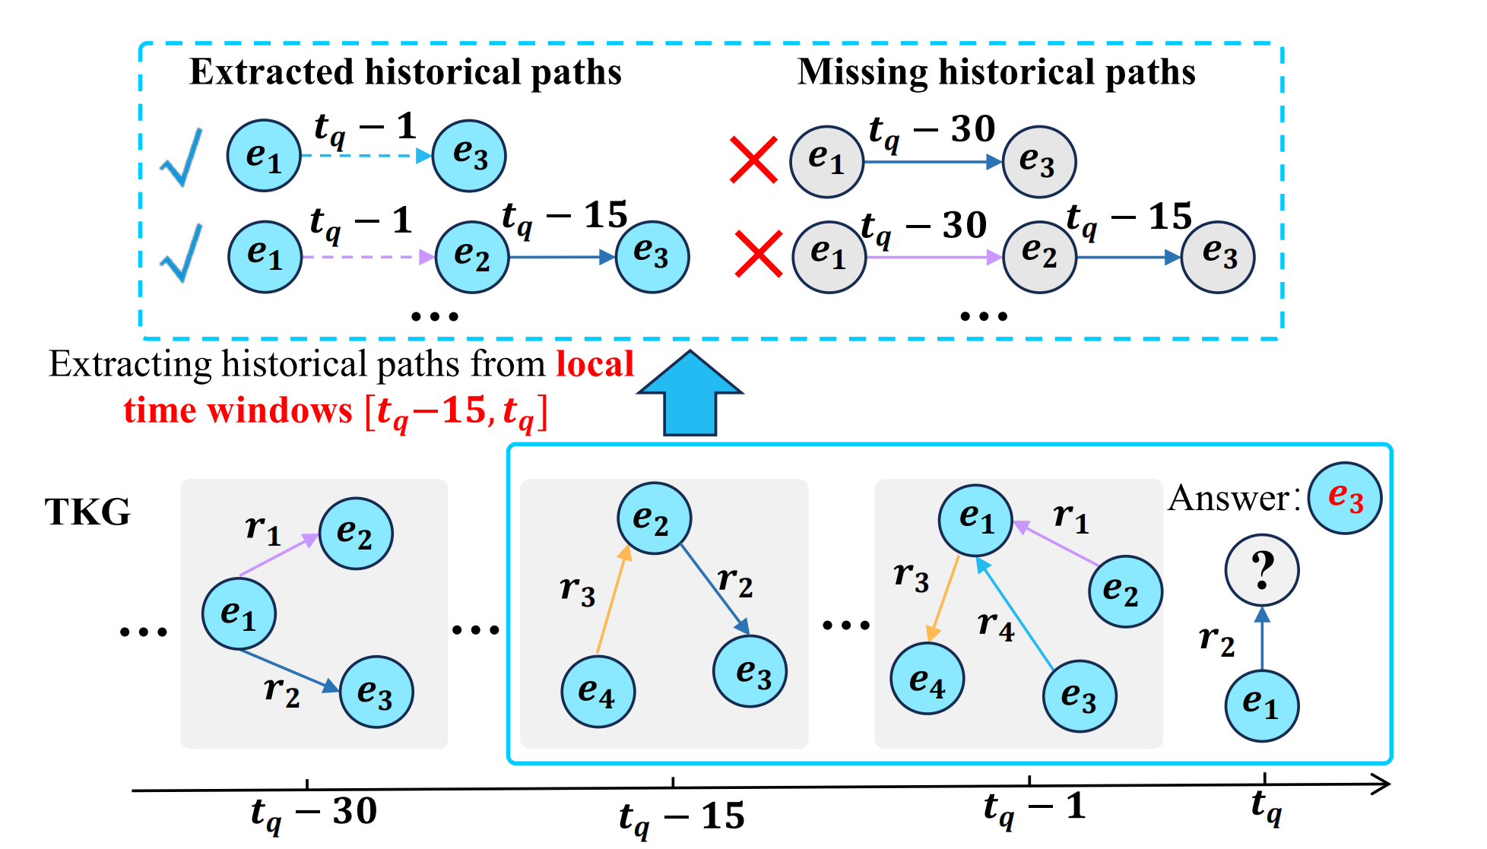
motivation
1. these path-based methods primarily focus on local temporal paths appearing in recent times, failing to capture the complex temporal paths in TKG and resulting in the loss of longer historical relations related to the query

Slide 3
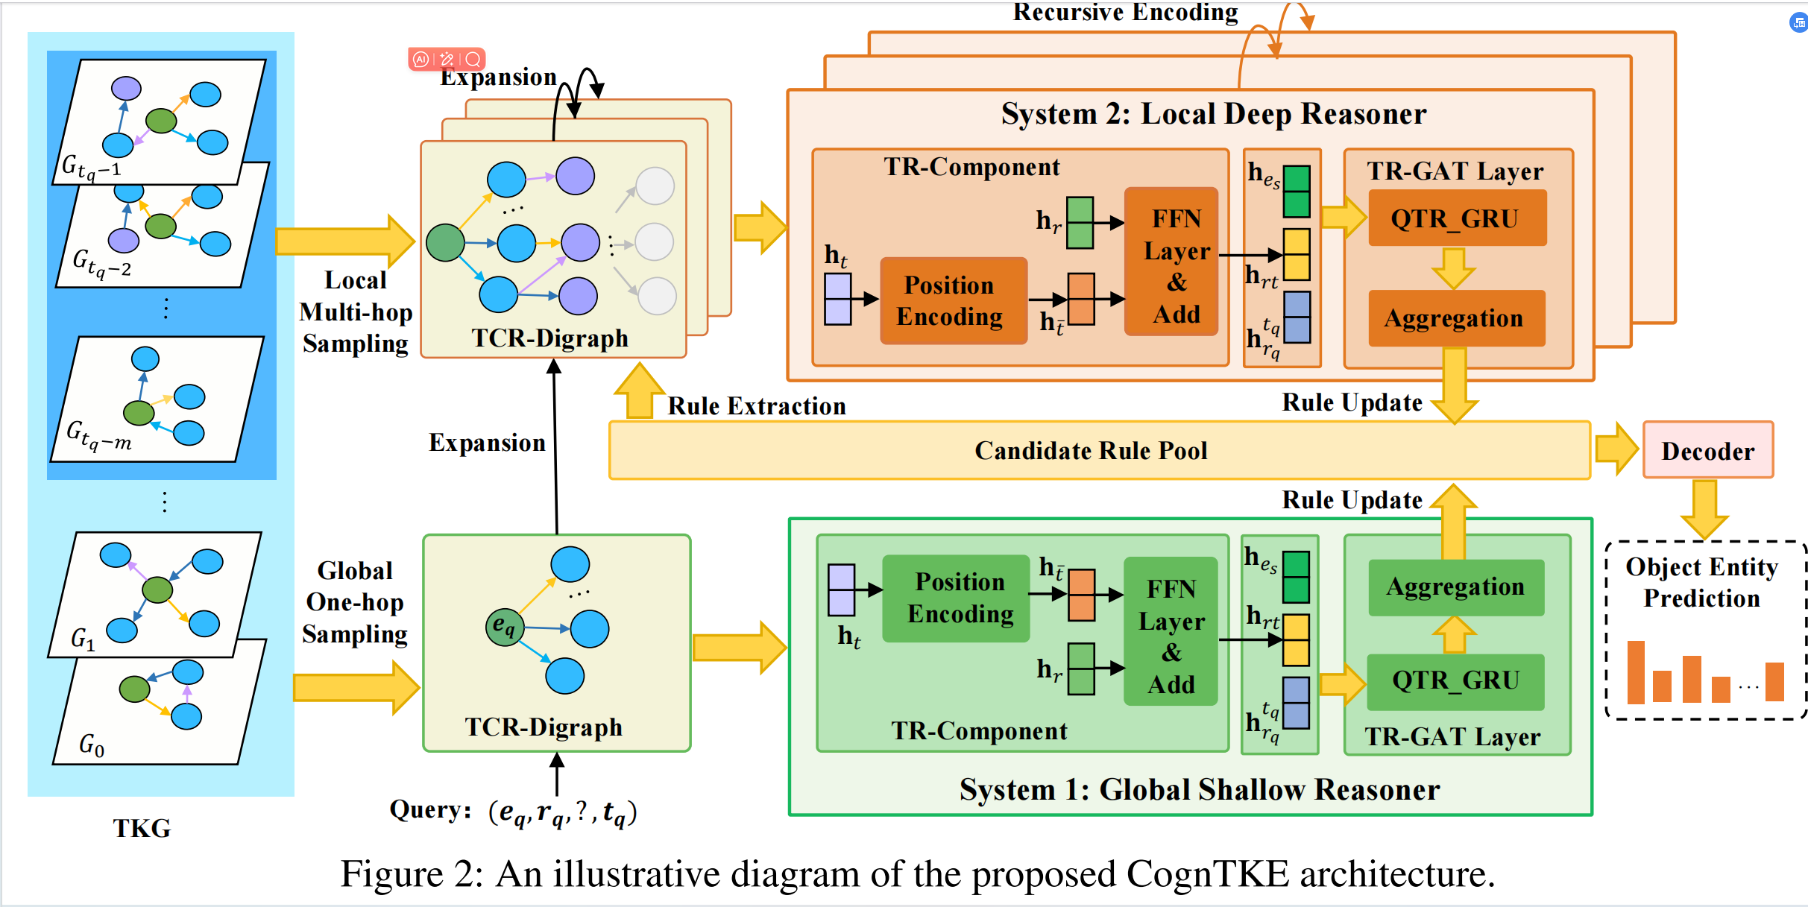
Overview

Slide 4
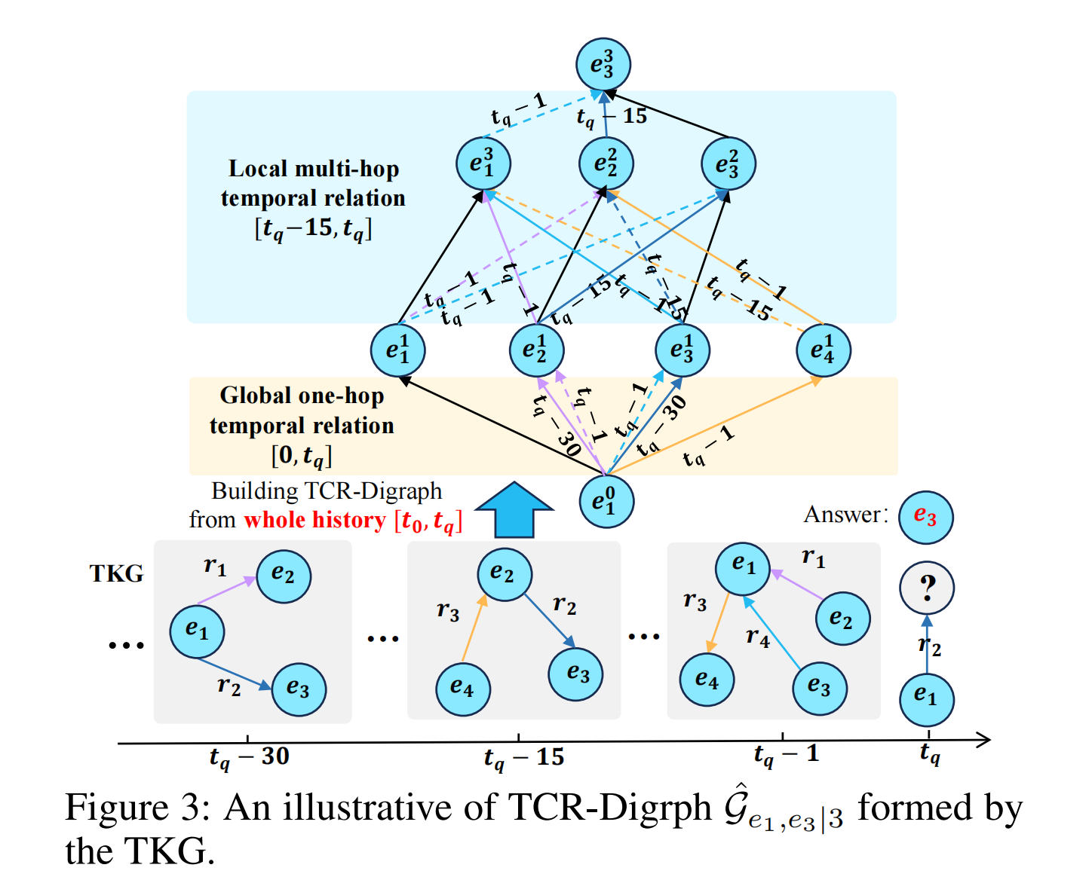
Approach

Slide 5
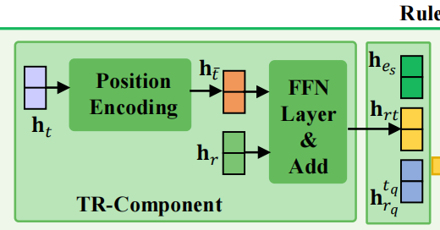
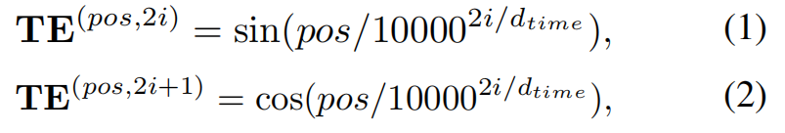
Approach

Slide 6

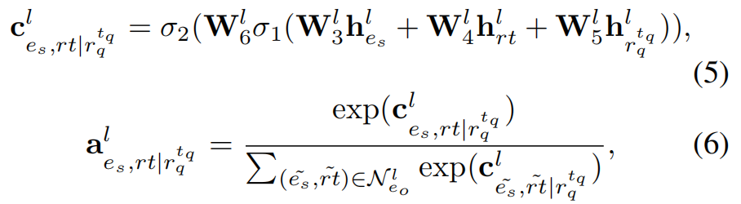
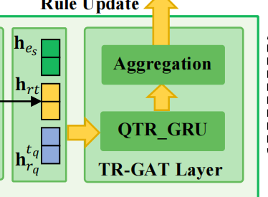
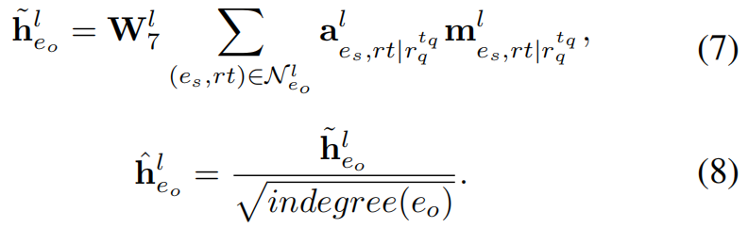

Approach

Slide 7
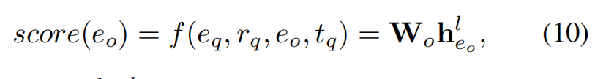
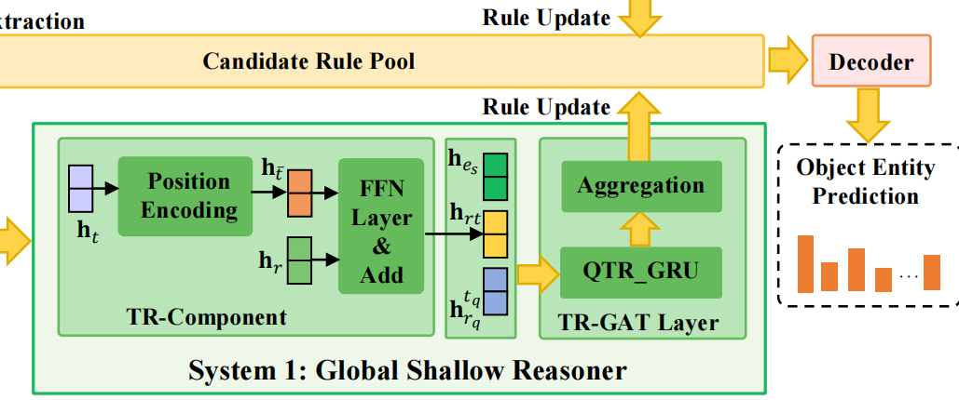
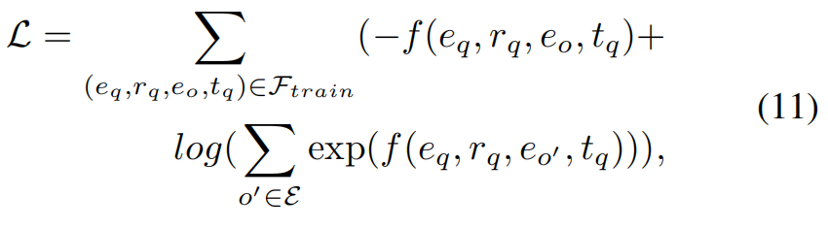
Approach

Slide 8
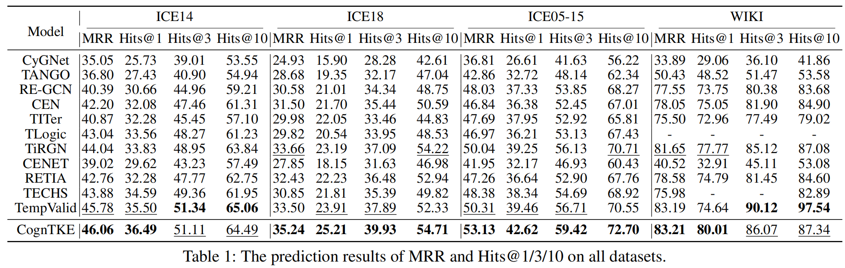
Experiment

Slide 9
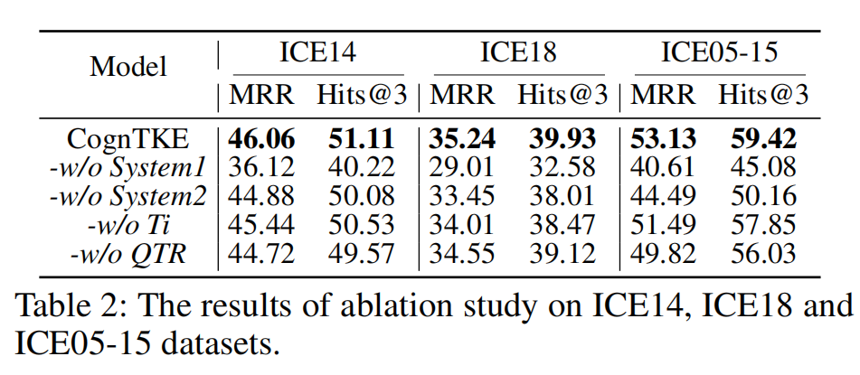
Experiment

Slide 10
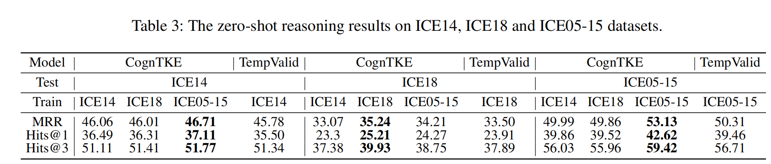
Experiment

Slide 11
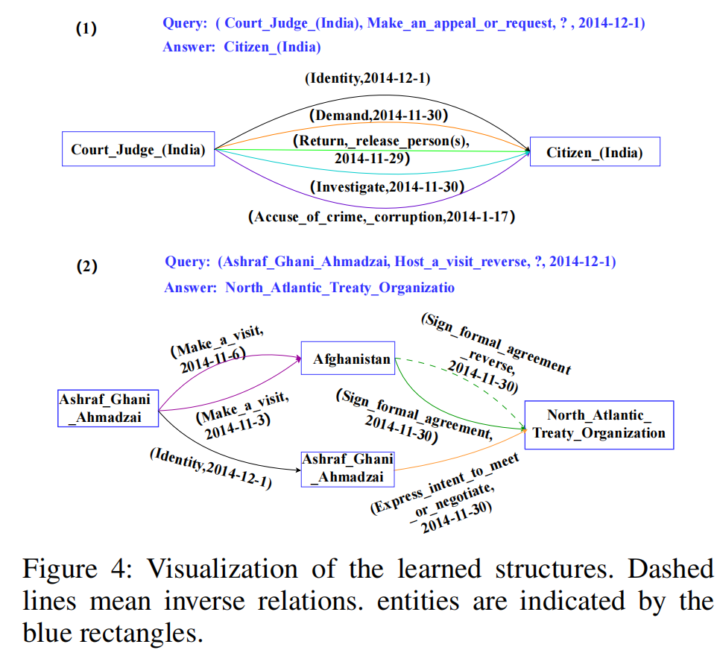
Experiment

Slide 12
Thank you!

